Slide 1






Retail Site Selection
Yaowen Liu, Guan Zheng Huang

Slide 2
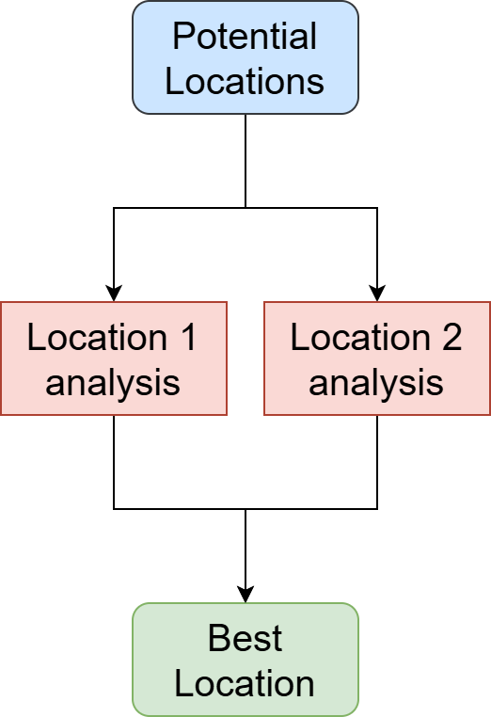

Introduction
Revenue
Store Location greatly impact
⛔complex, ⛔large data volume, ⛔experience-driven
SiteSage
Retail Site Evaluation System
Input: location, description
“A coffee shop on No. 288 Wuning Road”
Output: site scores (1-10) and explanation
“7.8 – The site is very close to …”
Notes:
40s
Traditional site selection depends on experience from the experts and locals, which is comparatively subjective
While Modern site selection utilizes data-driven tools such as geographic information system and machine learning to project a location to potential revenues, however it is still labor-intensive and expensive
The goal of the siteSage is to automate data analysis and expert analysis
SiteSage is an agentic system… it takes … and outputs

Slide 3
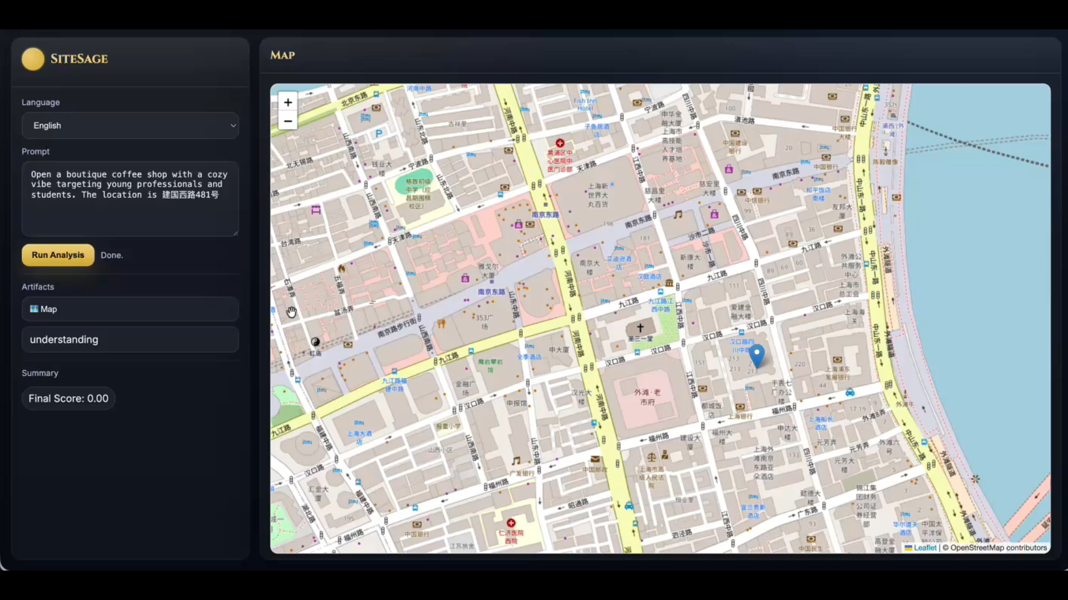

Demo
SiteSage

Slide 4
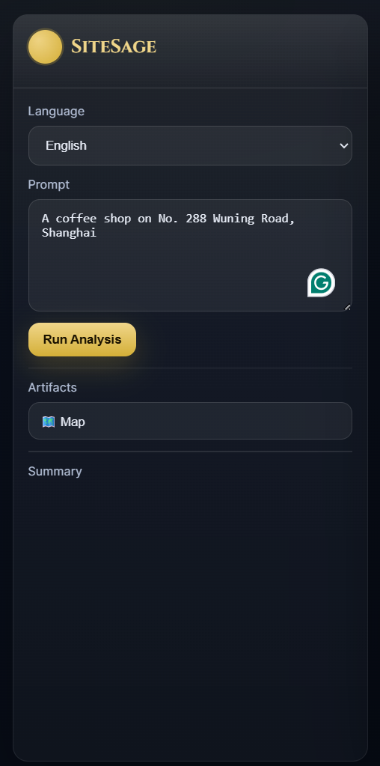
Example
Enter description + location
“A coffee shop on No. 288 Wuning Road”
SiteSage

Slide 5
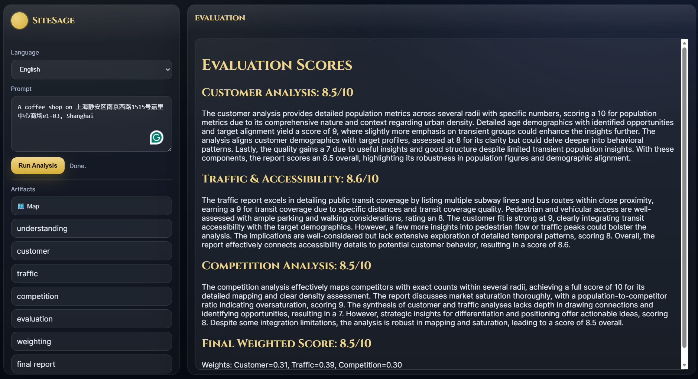
Example
Enter description + location
“A coffee shop on No. 288 Wuning Road”
2. Staged report appears
Traffic Report
Competitor Report
…
SiteSage

Slide 6
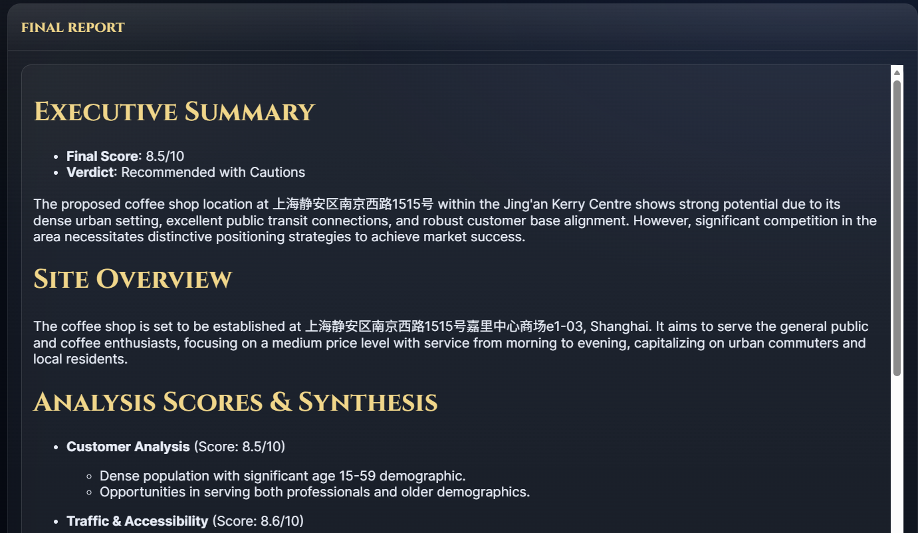
Example
Enter description + location
“A coffee shop on No. 288 Wuning Road”
2. Staged report appears
Traffic Report
Competitor Report
…
3. Final score and report
Score given against rubric
Qualitative explanation
SiteSage

Slide 7
Data and Labels
SiteSage
Agent accessible data
Amap API | geocoding, static map, nearby search
WorldPop API | population, age, gender
Web Search API | general information and public data (reviews, POIs)
Evaluation data
Dianping APP | 6-month average review count 3 brands: Starbucks, Arabica, Manner Coffee
Notes:
30s
The agent is accessible to the following data
Amap api
World pop demographics
Open Internet data
For evaluation, we use dianping to get store ratings and reviews as a proxy to project the customer traffic of stores.

Slide 8
Metrics of Success: Constrains
SiteSage
Location | Shanghai | Data availability Free API
Store type | Coffee Store | Ease of understanding Large Dataset Good traffic to user review to revenue relation
Notes:
30s
The agent is accessible to the following data
Amap api
World pop demographics
Open Internet data
For evaluation, we use dianping to get store ratings and reviews as a proxy to project the customer traffic of stores.

Slide 9
Metrics of Success: Comparative Ranking
SiteSage
Ground Truth
Starbucks A (5001 Dushi rd) | 41 reviews
Starbucks B (588 Dongch rd) | 16 reviews
Conclusion: Starbucks at Location A have more traffic
Ideally:
More review = More traffic
Same brand = Similar style
Notes:
30s
The agent is accessible to the following data
Amap api
World pop demographics
Open Internet data
For evaluation, we use dianping to get store ratings and reviews as a proxy to project the customer traffic of stores.

Slide 10
Metrics of Success: Comparative Ranking
SiteSage
Ground Truth
Starbucks A (5001 Dushi rd) | 41 reviews
Starbucks B (588 Dongch rd) | 16 reviews
Conclusion: Starbucks at Location A have more traffic
SiteSage Prediction
Location A (5001 Dushi rd) | SiteSage Score: 7.2
Location B (588 Dongch rd) | SiteSage Score: 5.1
Conclusion: Location A likely have more traffic
Notes:
30s
The agent is accessible to the following data
Amap api
World pop demographics
Open Internet data
For evaluation, we use dianping to get store ratings and reviews as a proxy to project the customer traffic of stores.

Slide 11
Metrics of Success: Comparative Ranking
SiteSage
Ground Truth
Conclusion: Location A
Agree
= Success pair
SiteSage Prediction
Conclusion: Location A
Notes:
30s
The agent is accessible to the following data
Amap api
World pop demographics
Open Internet data
For evaluation, we use dianping to get store ratings and reviews as a proxy to project the customer traffic of stores.

Slide 12
Metrics of Success: Comparative Ranking
SiteSage
Ground Truth
Conclusion: Location A
Agree
= Success pair
SiteSage Prediction
Conclusion: Location A
Accuracy
= Success pair / All pair
Notes:
30s
The agent is accessible to the following data
Amap api
World pop demographics
Open Internet data
For evaluation, we use dianping to get store ratings and reviews as a proxy to project the customer traffic of stores.

Slide 13
Metrics of Success: Comparative Ranking
SiteSage
Ground Truth
Conclusion: Location A
Agree
= Success pair
SiteSage Prediction
Conclusion: Location A
= 79% (30/38)
Accuracy
Notes:
30s
The agent is accessible to the following data
Amap api
World pop demographics
Open Internet data
For evaluation, we use dianping to get store ratings and reviews as a proxy to project the customer traffic of stores.

Slide 14
Metrics of Success: Failed Case
SiteSage
Ground Truth
5001 Dushi rd = 41 review > 14 Ningbuo rd = 38 review
Disagree
= Failed pair
SiteSage Prediction
5001 Dushi rd = 7.2 score < 14 Ningbuo rd = 7.5 score
Notes:
30s
The agent is accessible to the following data
Amap api
World pop demographics
Open Internet data
For evaluation, we use dianping to get store ratings and reviews as a proxy to project the customer traffic of stores.

Slide 15
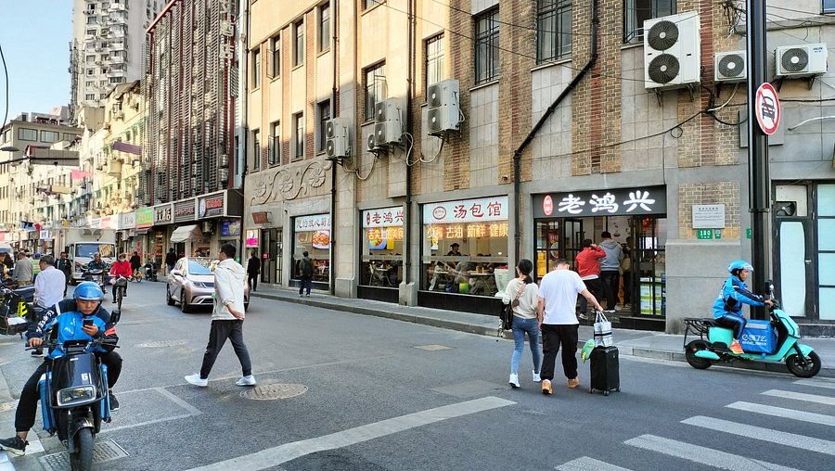
Metrics of Success: Failed Case
SiteSage
Ground Truth
5001 Dushi rd = 41 review > 14 Ningbuo rd = 38 review
Disagree
= Failed pair
SiteSage Prediction
5001 Dushi rd = 7.2 score < 14 Ningbuo rd = 7.5 score
Why?
Ningbuo rd got very high traffic score (9.0/10)
Busy Intersection = Correct
Public Transit = Correct
Missed ➜ Location UNDERGROUND!
Notes:
30s
The agent is accessible to the following data
Amap api
World pop demographics
Open Internet data
For evaluation, we use dianping to get store ratings and reviews as a proxy to project the customer traffic of stores.

Slide 16
Metrics of Success: Failed Case
SiteSage
Ground Truth
5001 Dushi rd = 41 review > 14 Ningbuo rd = 38 review
Disagree
= Failed pair
SiteSage Prediction
5001 Dushi rd = 7.2 score < 14 Ningbuo rd = 7.5 score
Why?
Issue
We have visibility analysis
Ningbuo rd got very high traffic score (9.0/10)
But no data show underground
Busy Intersection = Correct
Public Transit = Correct
Missed ➜ Location UNDERGROUND!
Ask for human input
Notes:
30s
The agent is accessible to the following data
Amap api
World pop demographics
Open Internet data
For evaluation, we use dianping to get store ratings and reviews as a proxy to project the customer traffic of stores.

Slide 17
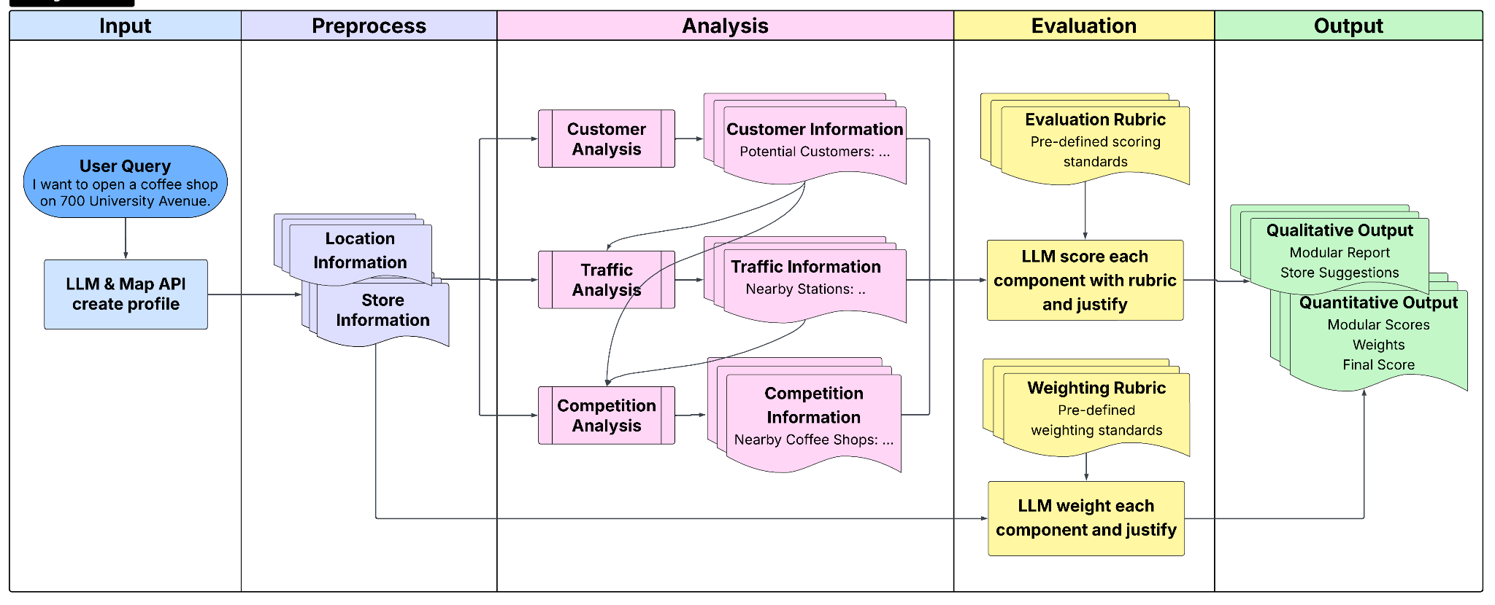
Architecture: System Workflow
SiteSage
Notes:
1min10s
This is the architecture of the SiteSage
It takes in user’s description of the store and location, preprocess the information to structured inputs: location and store information, for 3 consecutive analysis modules:xxx
Each module takes in the report from the previous module and generates a report based on its own instruction.
the reason for this design is to set up checkpoints between the modules so debug is easier.
After this, llm scores each component with predefined rubric and justify.
On the other side, store information will be analyzed as weights for each module with predefined weighting rubric
The purpose of this step is to cater to store’s own need and remove the bias in multi-site selection scenario
Together with analysis reports, the framework outputs qualitative and quantitative results for the user.

Slide 18
Architecture: System Workflow
SiteSage
Location | Lng, Lat, Map
Store | Rewrite user input
Notes:
1min10s
This is the architecture of the SiteSage
It takes in user’s description of the store and location, preprocess the information to structured inputs: location and store information, for 3 consecutive analysis modules:xxx
Each module takes in the report from the previous module and generates a report based on its own instruction.
the reason for this design is to set up checkpoints between the modules so debug is easier.
After this, llm scores each component with predefined rubric and justify.
On the other side, store information will be analyzed as weights for each module with predefined weighting rubric
The purpose of this step is to cater to store’s own need and remove the bias in multi-site selection scenario
Together with analysis reports, the framework outputs qualitative and quantitative results for the user.

Slide 19
Architecture: System Workflow
SiteSage
Customer | Demographics
Traffic | Public Transit / Parking Detour estimation Visibility analysis
Competition | Similar store Market Saturation
Notes:
1min10s
This is the architecture of the SiteSage
It takes in user’s description of the store and location, preprocess the information to structured inputs: location and store information, for 3 consecutive analysis modules:xxx
Each module takes in the report from the previous module and generates a report based on its own instruction.
the reason for this design is to set up checkpoints between the modules so debug is easier.
After this, llm scores each component with predefined rubric and justify.
On the other side, store information will be analyzed as weights for each module with predefined weighting rubric
The purpose of this step is to cater to store’s own need and remove the bias in multi-site selection scenario
Together with analysis reports, the framework outputs qualitative and quantitative results for the user.

Slide 20
Architecture: System Workflow
SiteSage
Notes:
1min10s
This is the architecture of the SiteSage
It takes in user’s description of the store and location, preprocess the information to structured inputs: location and store information, for 3 consecutive analysis modules:xxx
Each module takes in the report from the previous module and generates a report based on its own instruction.
the reason for this design is to set up checkpoints between the modules so debug is easier.
After this, llm scores each component with predefined rubric and justify.
On the other side, store information will be analyzed as weights for each module with predefined weighting rubric
The purpose of this step is to cater to store’s own need and remove the bias in multi-site selection scenario
Together with analysis reports, the framework outputs qualitative and quantitative results for the user.

Slide 21
Training and Testing
SiteSage
Prompt Tuning
Testing Data
Data: 5 stores from Starbucks
Manual + automatic rubric prompt tuning
Manual report agent prompt tuning
Accuracy: 80%
8 stores from Manner Coffee -> 28 pairs
5 stores from % Arabica Coffee -> 10 pairs
Notes:
1min10s
This is the architecture of the SiteSage
It takes in user’s description of the store and location, preprocess the information to structured inputs: location and store information, for 3 consecutive analysis modules:xxx
Each module takes in the report from the previous module and generates a report based on its own instruction.
the reason for this design is to set up checkpoints between the modules so debug is easier.
After this, llm scores each component with predefined rubric and justify.
On the other side, store information will be analyzed as weights for each module with predefined weighting rubric
The purpose of this step is to cater to store’s own need and remove the bias in multi-site selection scenario
Together with analysis reports, the framework outputs qualitative and quantitative results for the user.

Slide 22
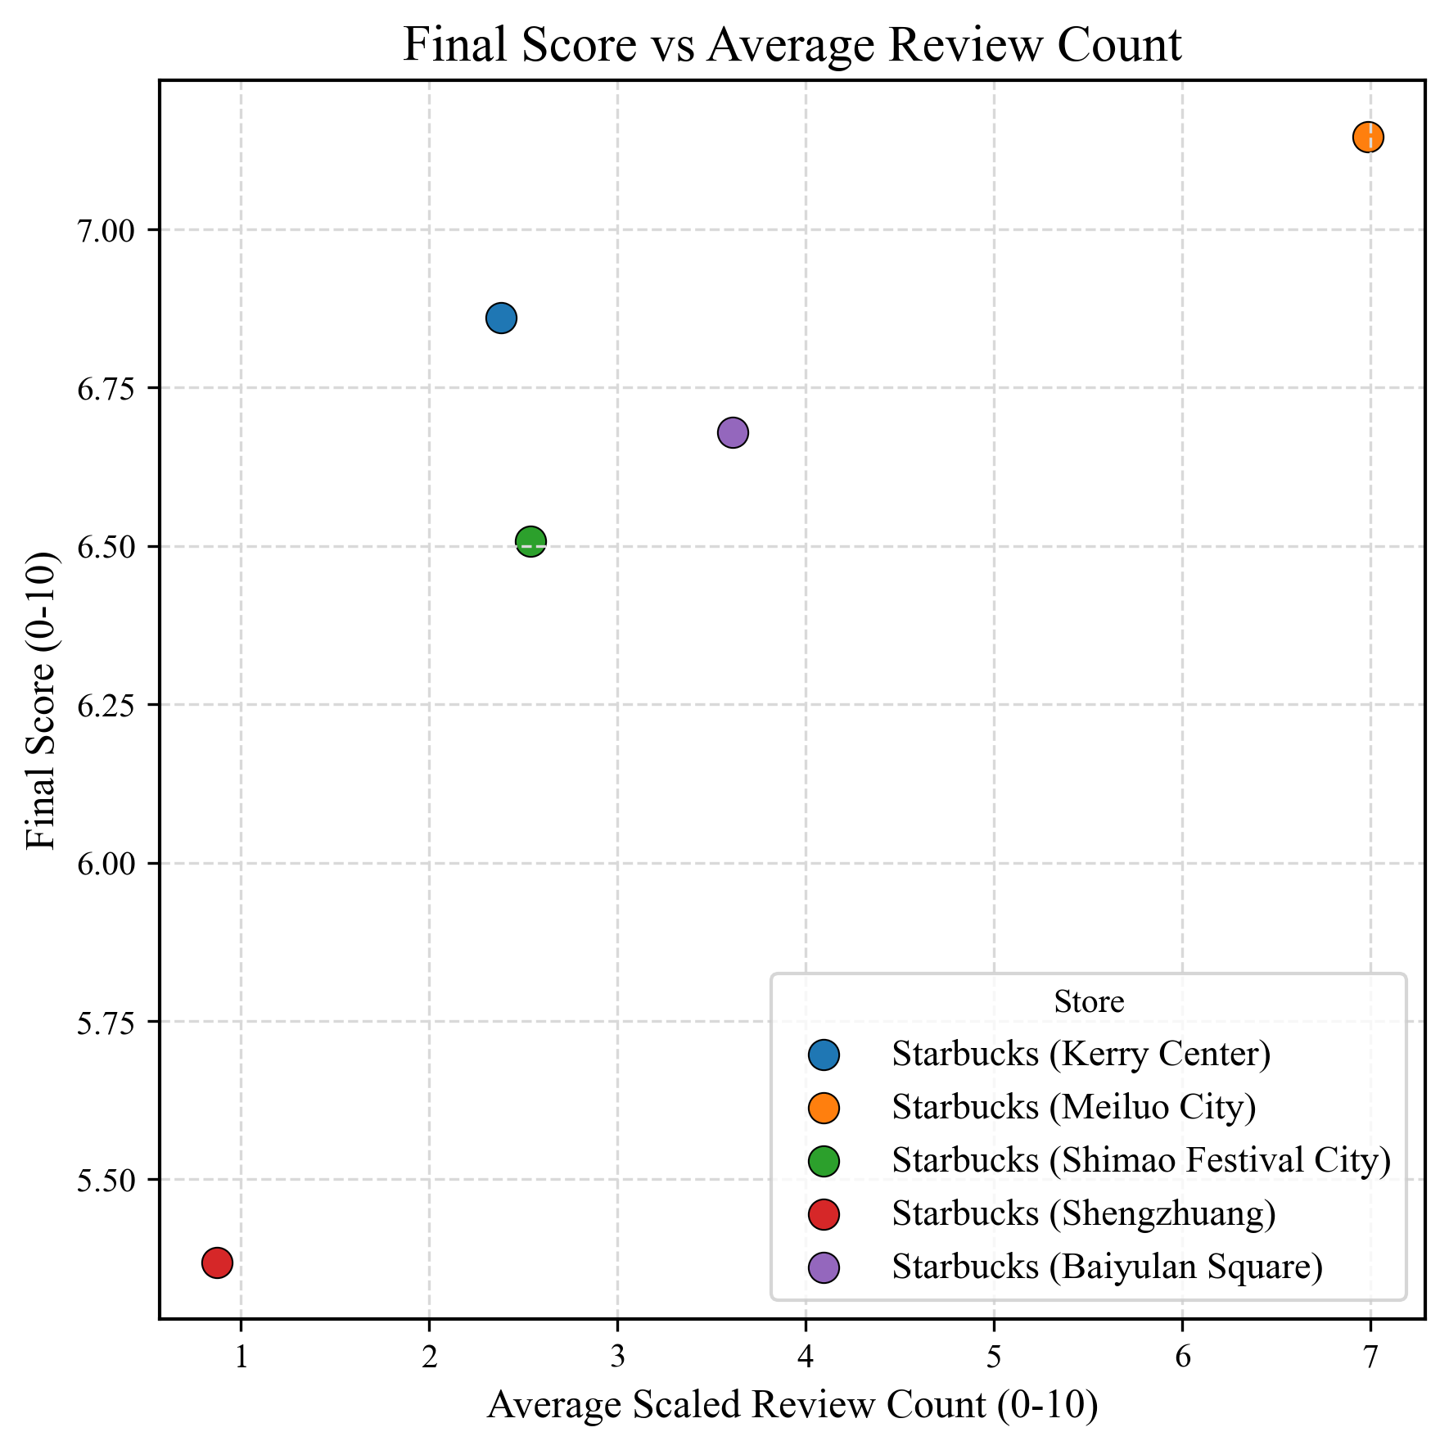
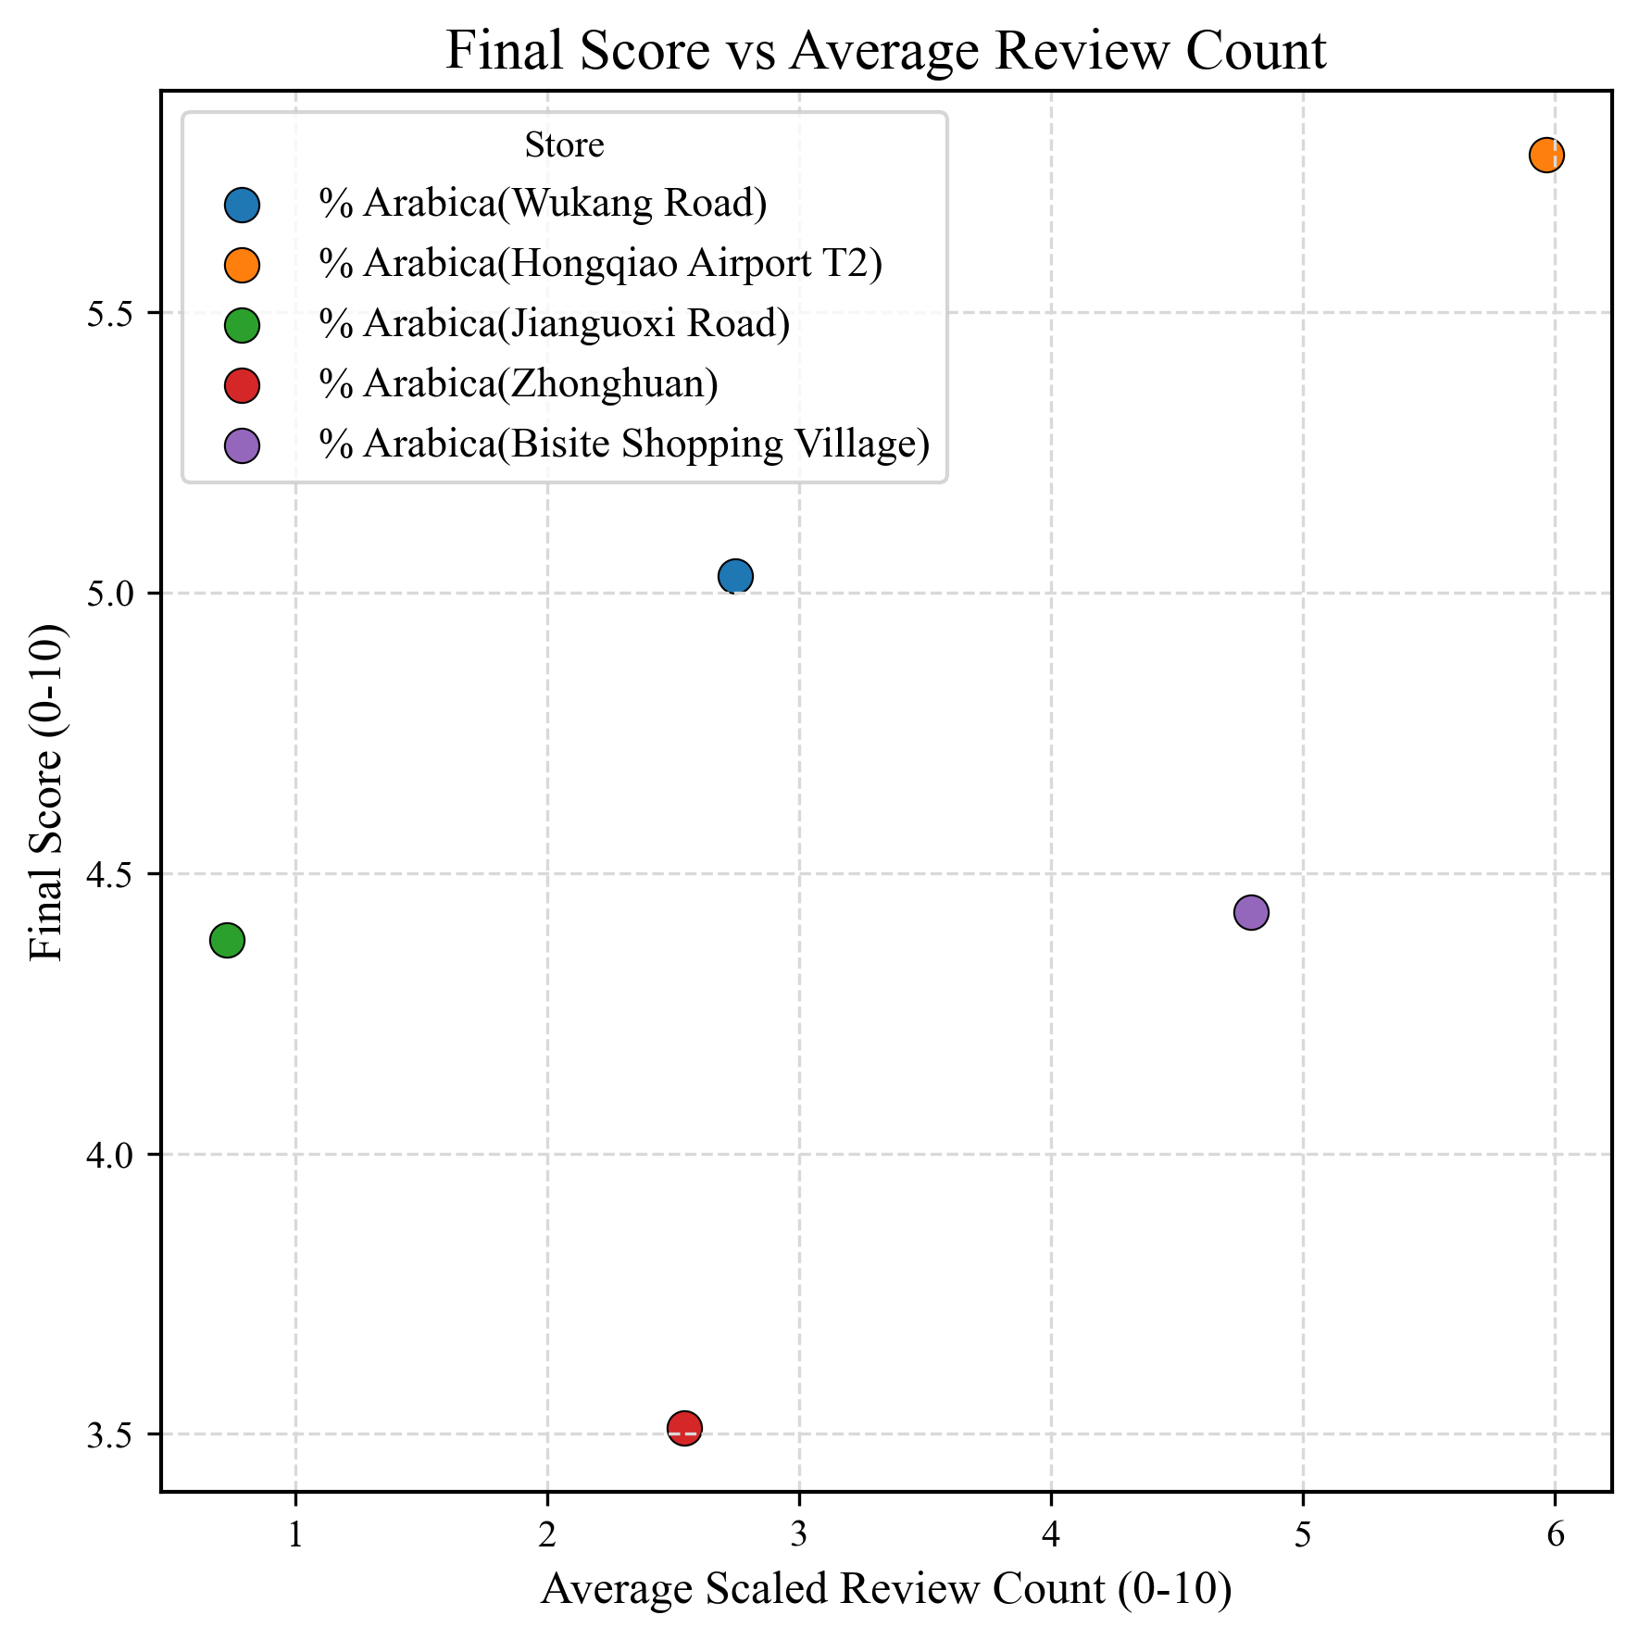
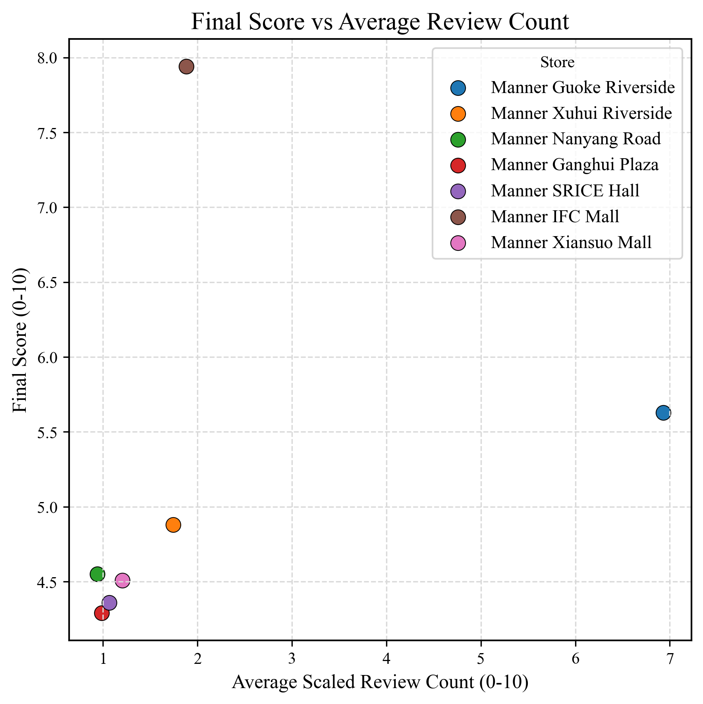
Quantitative Results
SiteSage
Train
Test
Starbucks
Accuracy: 80%
% Arabica
Accuracy: 80%
Manner Coffee
Accuracy: 78.57%
More Reviews
Higher Score
Less Reviews
Lower Score
Notes:
1min10s
This is the architecture of the SiteSage
It takes in user’s description of the store and location, preprocess the information to structured inputs: location and store information, for 3 consecutive analysis modules:xxx
Each module takes in the report from the previous module and generates a report based on its own instruction.
the reason for this design is to set up checkpoints between the modules so debug is easier.
After this, llm scores each component with predefined rubric and justify.
On the other side, store information will be analyzed as weights for each module with predefined weighting rubric
The purpose of this step is to cater to store’s own need and remove the bias in multi-site selection scenario
Together with analysis reports, the framework outputs qualitative and quantitative results for the user.

Slide 23
Conclusion
SiteSage
Result
Accuracy: 79% (30/38)
Notes:
1min10s
This is the architecture of the SiteSage
It takes in user’s description of the store and location, preprocess the information to structured inputs: location and store information, for 3 consecutive analysis modules:xxx
Each module takes in the report from the previous module and generates a report based on its own instruction.
the reason for this design is to set up checkpoints between the modules so debug is easier.
After this, llm scores each component with predefined rubric and justify.
On the other side, store information will be analyzed as weights for each module with predefined weighting rubric
The purpose of this step is to cater to store’s own need and remove the bias in multi-site selection scenario
Together with analysis reports, the framework outputs qualitative and quantitative results for the user.

Slide 24
Conclusion
SiteSage
Result
Accuracy: 79% (30/38)
Comment:
Weak Spot:
Result makes sense – Customer, Traffic, Competitor ➜ final score
Generalizability
Good UX experience
Overly Absolute Rubrics
Low Review Count -> Hard to Compare some Locations
Date drift in search result
Notes:
1min10s
This is the architecture of the SiteSage
It takes in user’s description of the store and location, preprocess the information to structured inputs: location and store information, for 3 consecutive analysis modules:xxx
Each module takes in the report from the previous module and generates a report based on its own instruction.
the reason for this design is to set up checkpoints between the modules so debug is easier.
After this, llm scores each component with predefined rubric and justify.
On the other side, store information will be analyzed as weights for each module with predefined weighting rubric
The purpose of this step is to cater to store’s own need and remove the bias in multi-site selection scenario
Together with analysis reports, the framework outputs qualitative and quantitative results for the user.

Slide 25
Conclusion
SiteSage
Result
Accuracy: 79% (30/38)
Comment:
Weak Spot:
Result makes sense – Customer, Traffic, Competitor ➜ final score
Generalizability
Good UX experience
Overly Absolute Rubrics
Low Review Count -> Hard to Compare some Locations
Date drift in search result
Insights for Future Project:
Set experiment domain in Canada ➜ more relevant
Consider date drifting problem
Generalizable and Learnable Prompt and Rubric
Notes:
1min10s
This is the architecture of the SiteSage
It takes in user’s description of the store and location, preprocess the information to structured inputs: location and store information, for 3 consecutive analysis modules:xxx
Each module takes in the report from the previous module and generates a report based on its own instruction.
the reason for this design is to set up checkpoints between the modules so debug is easier.
After this, llm scores each component with predefined rubric and justify.
On the other side, store information will be analyzed as weights for each module with predefined weighting rubric
The purpose of this step is to cater to store’s own need and remove the bias in multi-site selection scenario
Together with analysis reports, the framework outputs qualitative and quantitative results for the user.

Slide 26

Questions
Yaowen Liu, Guan Zheng Huang

Slide 27
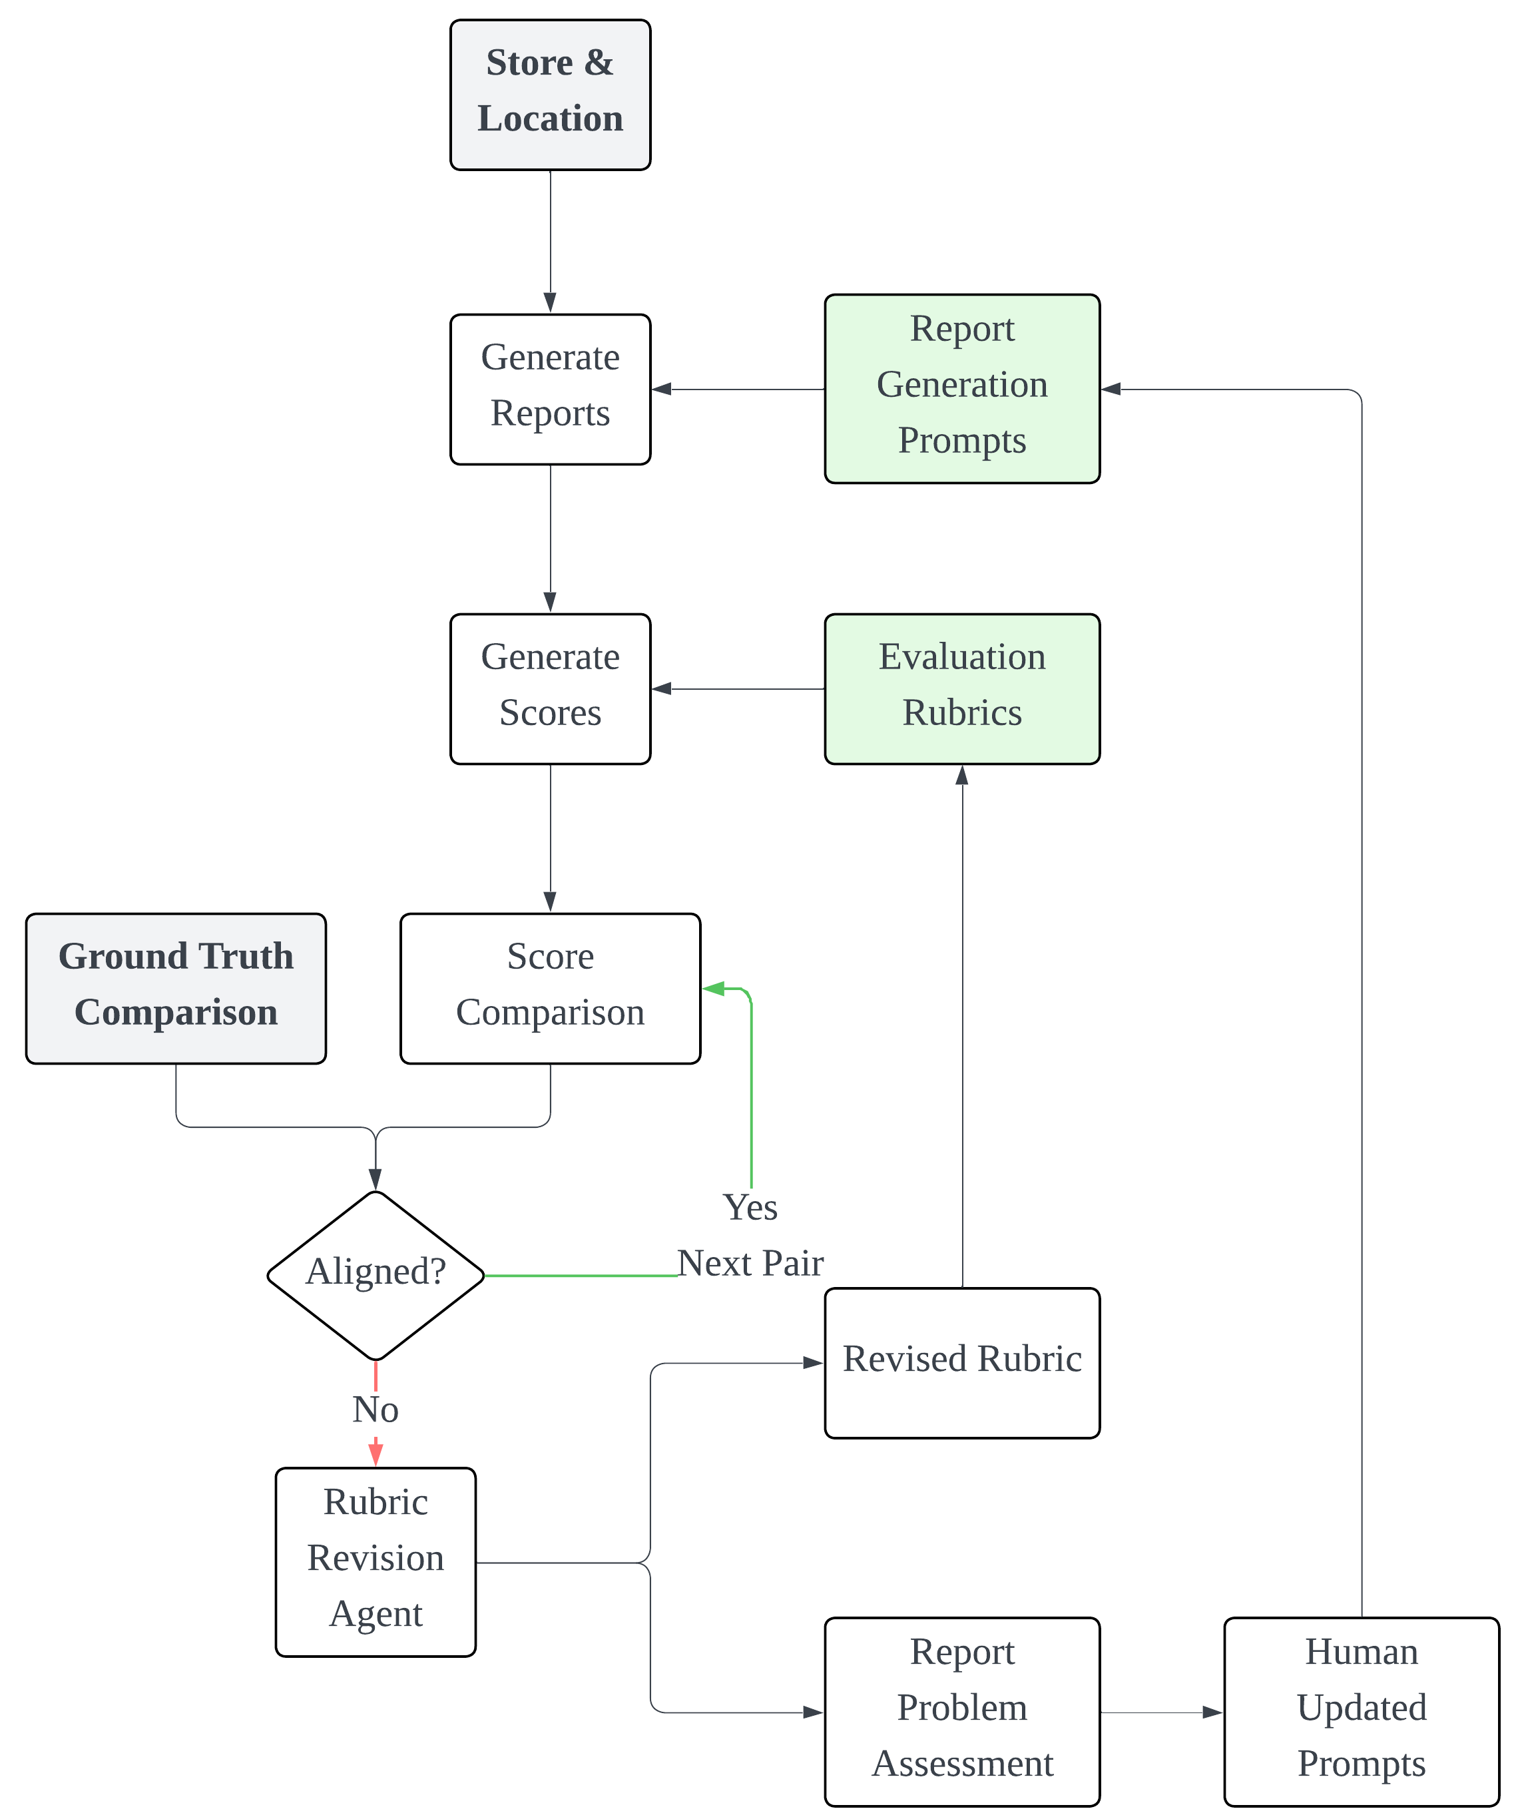
Appendix: Training and Testing
SiteSage
Training
Training data: 5 stores from Starbucks
Manual + automatic rubric prompt tuning
Manual report agent prompt tuning
Testing Data
8 stores from Manner
5 stores from Arabica
Training Process
Notes:
1min10s
This is the architecture of the SiteSage
It takes in user’s description of the store and location, preprocess the information to structured inputs: location and store information, for 3 consecutive analysis modules:xxx
Each module takes in the report from the previous module and generates a report based on its own instruction.
the reason for this design is to set up checkpoints between the modules so debug is easier.
After this, llm scores each component with predefined rubric and justify.
On the other side, store information will be analyzed as weights for each module with predefined weighting rubric
The purpose of this step is to cater to store’s own need and remove the bias in multi-site selection scenario
Together with analysis reports, the framework outputs qualitative and quantitative results for the user.

Slide 28
Appendix: Sample output
SiteSage
# Executive Summary
- **Final Score**: 8.5/10
- **Verdict**: Recommended with Cautions
The proposed coffee shop location at 上海静安区南京西路1515号 within the Jing'an Kerry Centre shows strong potential due to its dense urban setting, excellent public transit connections, and robust customer base alignment. However, significant competition in the area necessitates distinctive positioning strategies to achieve market success.
# Site Overview
The coffee shop is set to be established at 上海静安区南京西路1515号嘉里中心商场e1-03, Shanghai. It aims to serve the general public and coffee enthusiasts, focusing on a medium price level with service from morning to evening, capitalizing on urban commuters and local residents.
# Analysis Scores & Synthesis
- **Customer Analysis** (Score: 8.5/10)
- Dense population with significant age 15-59 demographic.
- Opportunities in serving both professionals and older demographics.
- **Traffic & Accessibility** (Score: 8.6/10)
- Proximity to subway and bus stations.
- Ample parking enhances accessibility, maximizing customer convenience.
- **Competition Landscape** (Score: 8.5/10)
- Saturated market within 500 meters.
- Close proximity to well-established competitors like Starbucks.
- Weighting is justified by prioritizing foot traffic and accessibility (39%) over customer metrics (31%) and competitive pressures (30%).
# Strategic Assessment …
Notes:
1min10s
This is the architecture of the SiteSage
It takes in user’s description of the store and location, preprocess the information to structured inputs: location and store information, for 3 consecutive analysis modules:xxx
Each module takes in the report from the previous module and generates a report based on its own instruction.
the reason for this design is to set up checkpoints between the modules so debug is easier.
After this, llm scores each component with predefined rubric and justify.
On the other side, store information will be analyzed as weights for each module with predefined weighting rubric
The purpose of this step is to cater to store’s own need and remove the bias in multi-site selection scenario
Together with analysis reports, the framework outputs qualitative and quantitative results for the user.

Slide 29
Appendix: Sample Report Header
SiteSage
Customer | Demographics Nearby Places Main Customer Sources Customer Number Estimation
Traffic | Nearby Public Transit / Parking Customer flow analysis Detour estimation Visibility analysis
Competitor | Nearest Competitors Market Saturation Assessment Competitive Positioning Analysis
Notes:
1min10s
This is the architecture of the SiteSage
It takes in user’s description of the store and location, preprocess the information to structured inputs: location and store information, for 3 consecutive analysis modules:xxx
Each module takes in the report from the previous module and generates a report based on its own instruction.
the reason for this design is to set up checkpoints between the modules so debug is easier.
After this, llm scores each component with predefined rubric and justify.
On the other side, store information will be analyzed as weights for each module with predefined weighting rubric
The purpose of this step is to cater to store’s own need and remove the bias in multi-site selection scenario
Together with analysis reports, the framework outputs qualitative and quantitative results for the user.

